Slide 1
Clinic management system
“Project 3”
Group members:
Sara ahmed
Menna Khaled
Noha Alsayed
Habiba Essam

Slide 2
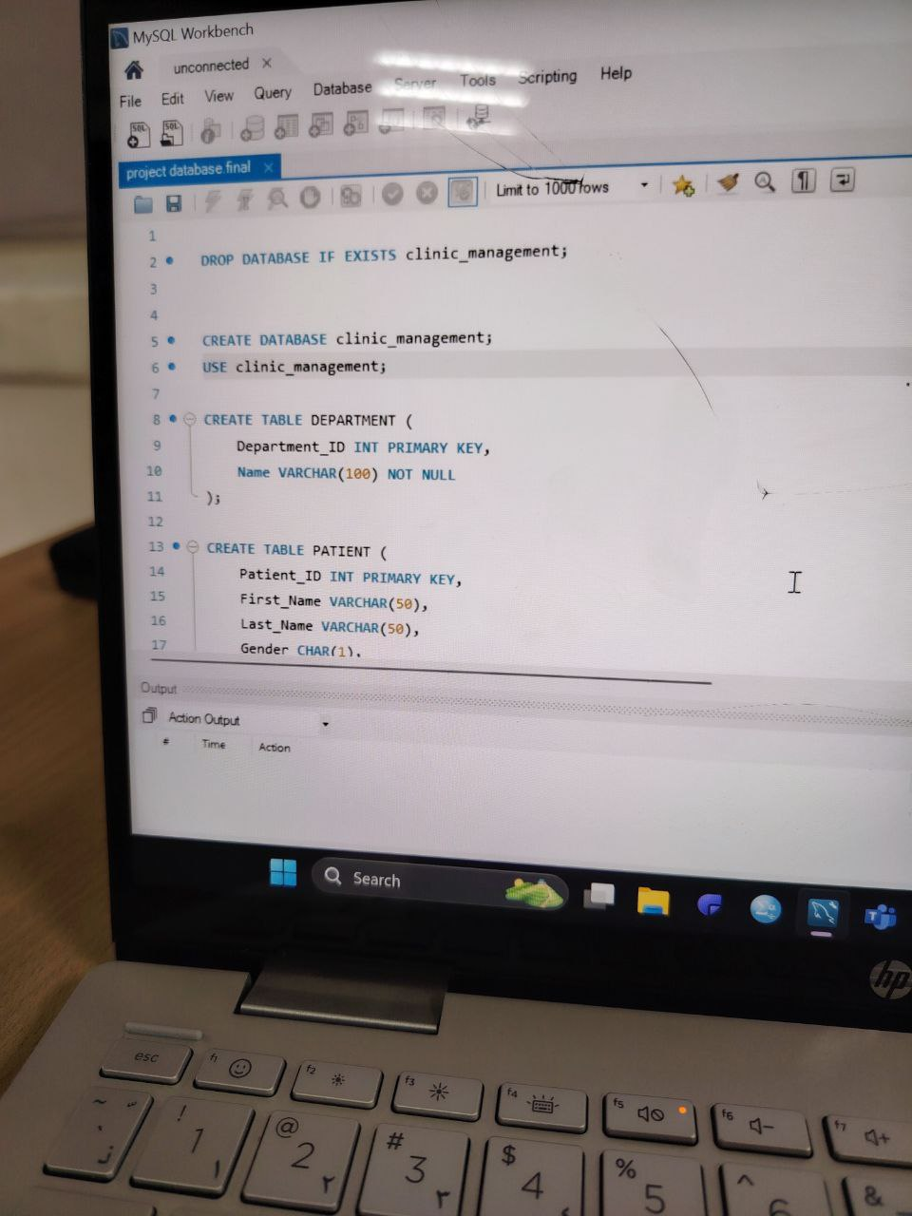
Overview:
Our Clinic Management System project is focused on making an organized and accurate database to manage the main operations of a medical clinic. These operations include booking the patients appointments, keeping track of the medical records, managing clinic information, and monitoring the availability of the doctors. while doing that, we may face little challenges like overlapping appointments or issues with manual record keeping. The database will help in making the patient information easier to access and more accurate, and that will lead to faster and more dependable healthcare services
habiba essam

Slide 3
Now we’re going to explain what we did step by step..

Slide 4
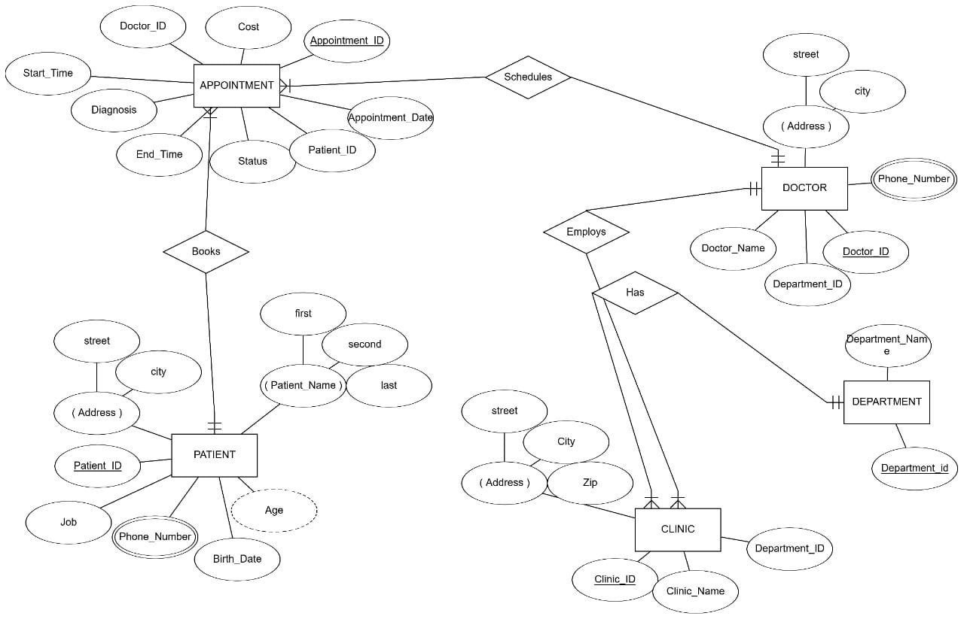
First step: ER diagram
Habiba essam

Slide 5
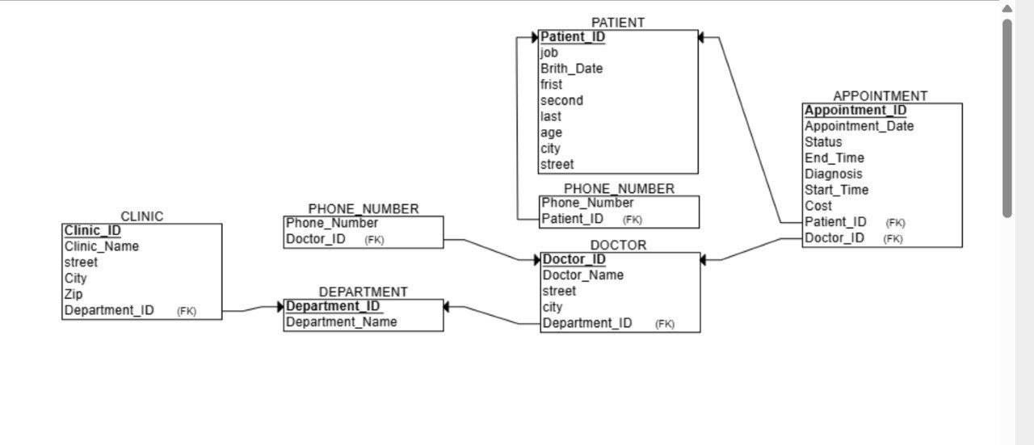
Second step: relational schema
Habiba essam

Slide 6
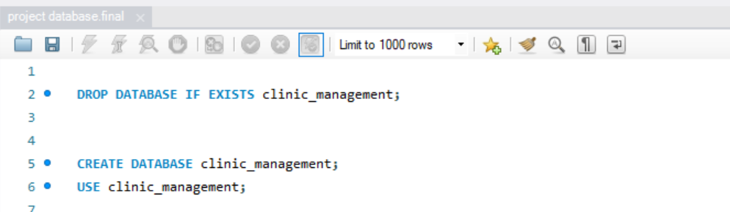
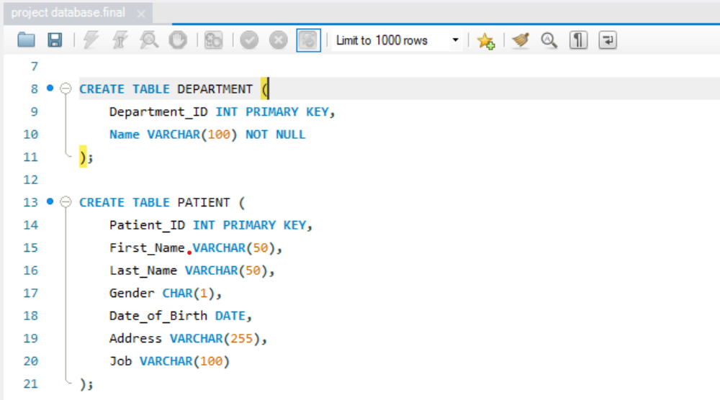
Third step: SQL code
Noha alsayed

Slide 7
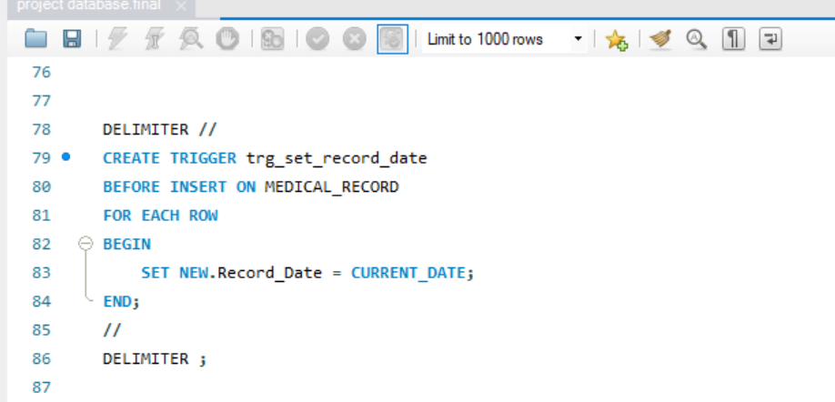
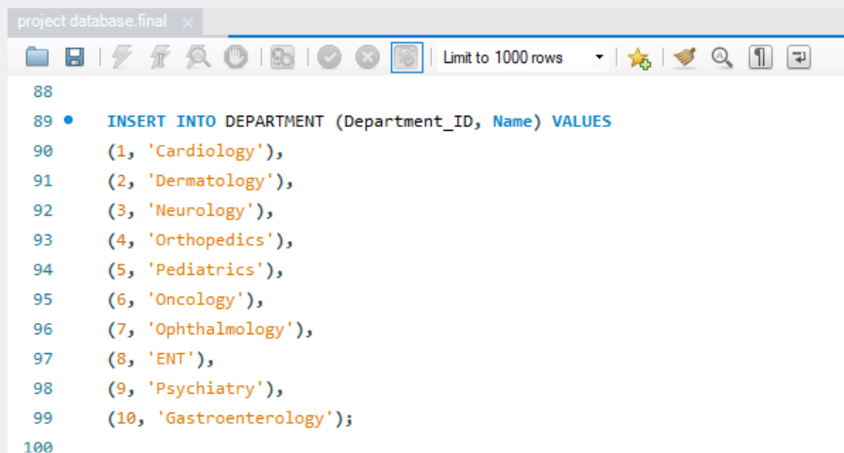
Noha alsayed

Slide 8
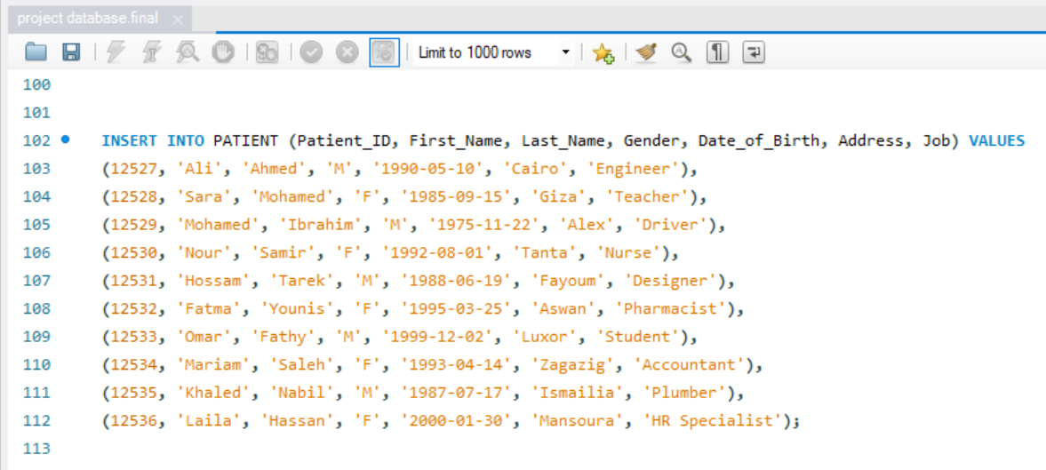
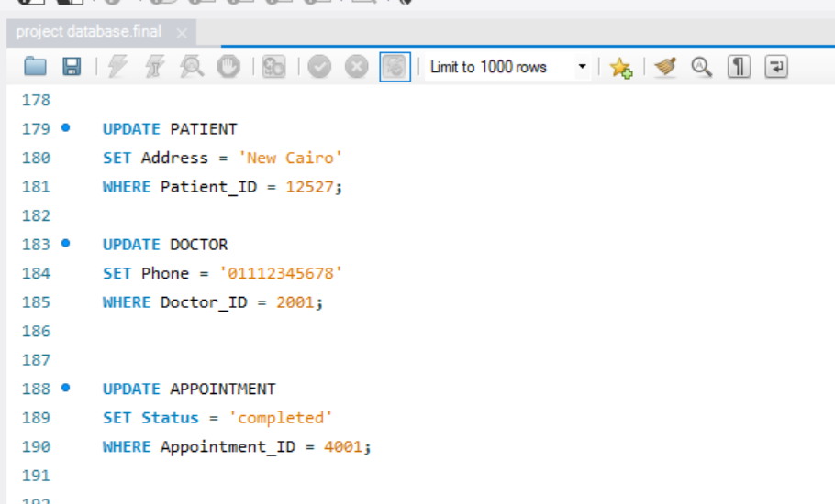
Noha alsayed

Slide 9
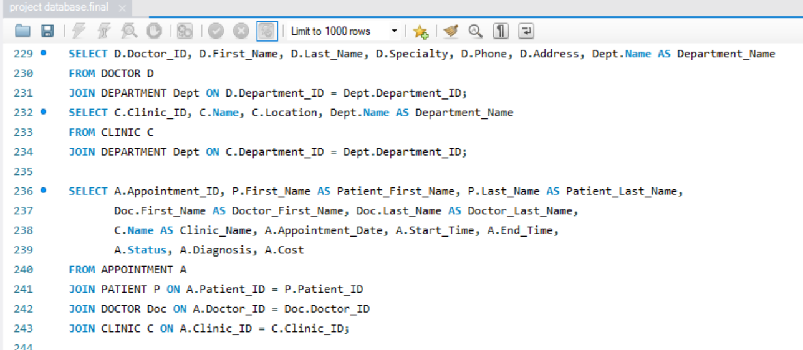
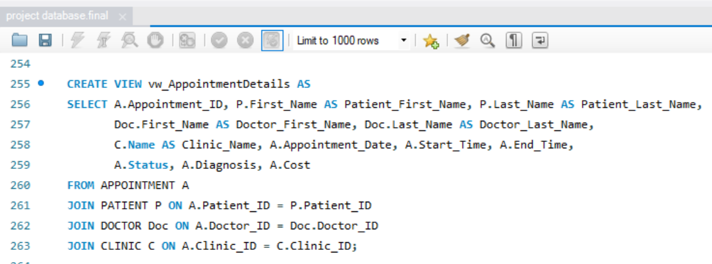
Noha alsayed

Slide 10
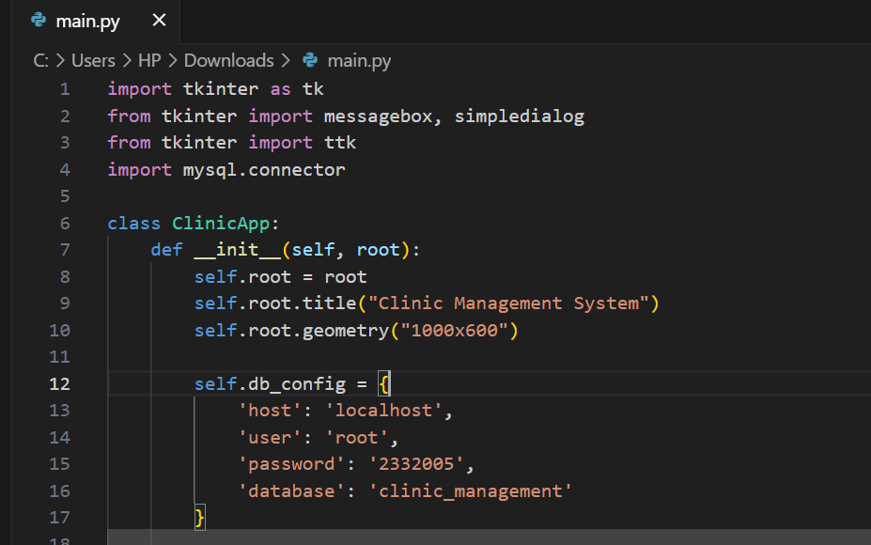
Fourth step: the bonus (GUI)
Sara ahmed

Slide 11
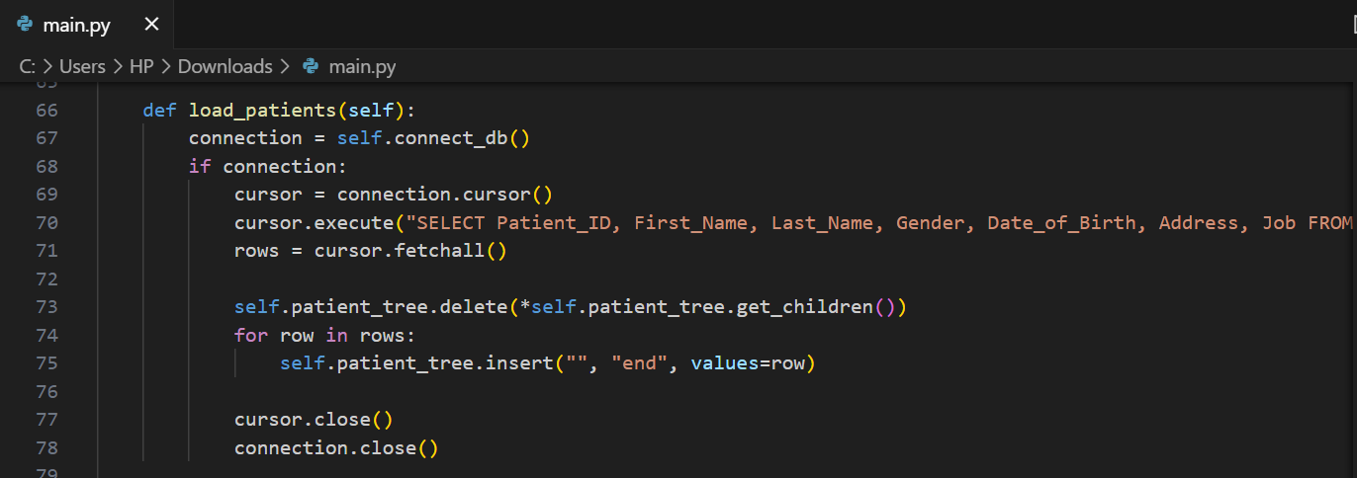
Sara ahmed

Slide 12
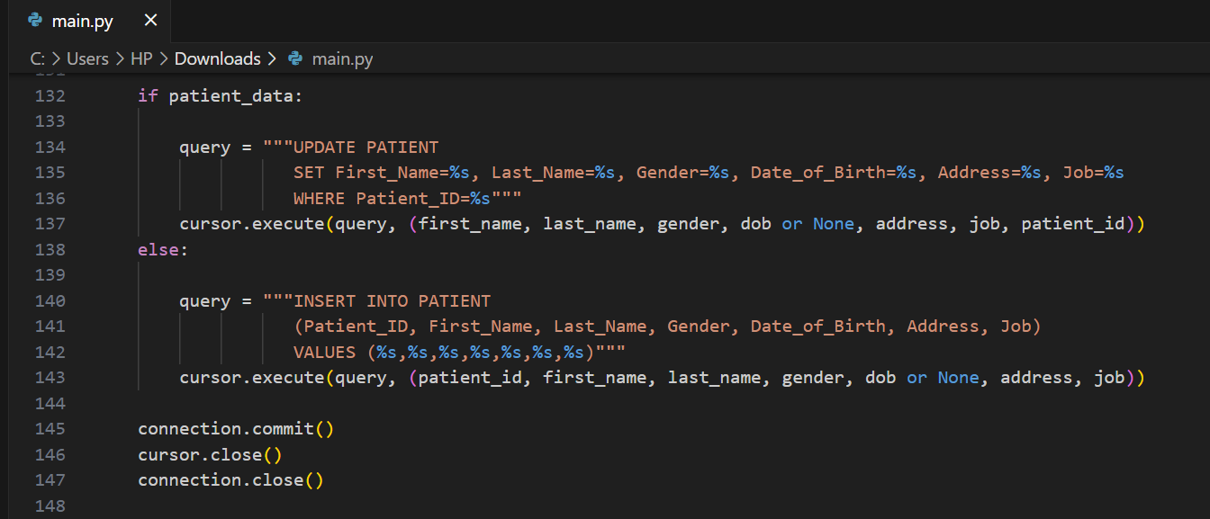
Menna khaled

Slide 13
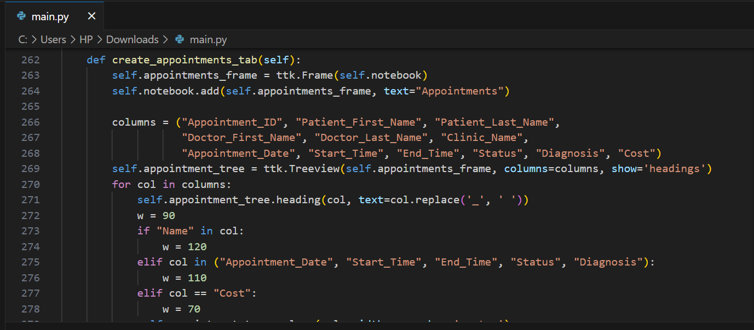
Menna khaled

Slide 14
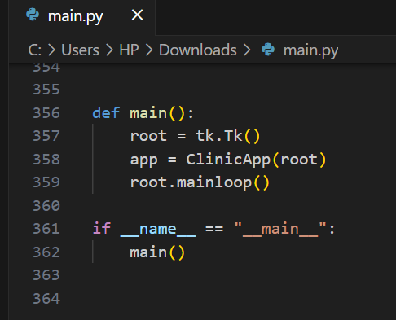
Menna khaled

Slide 15
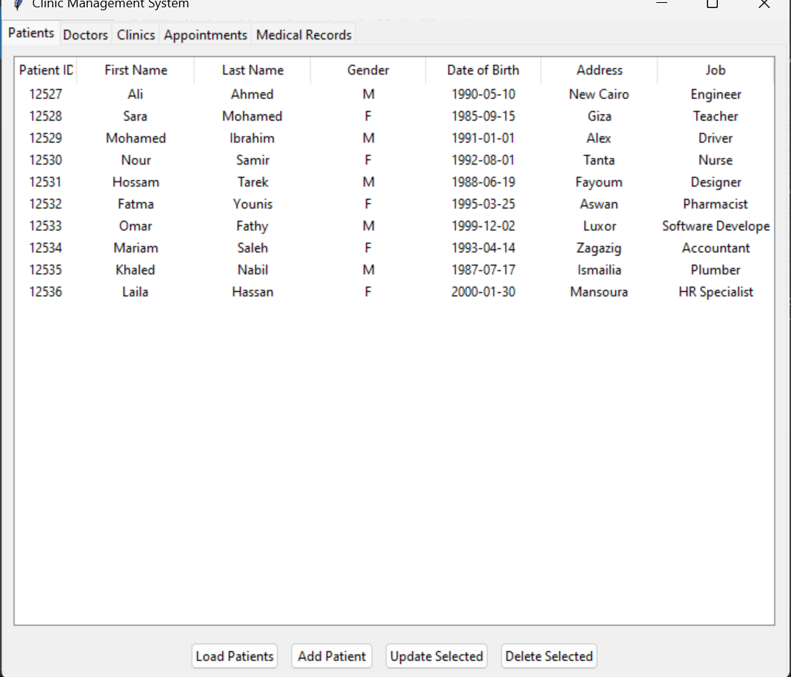
The final view: Patient Records

Slide 16
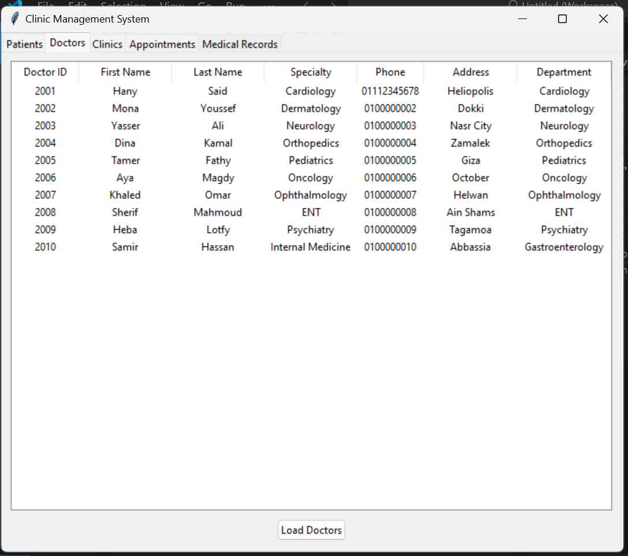
Doctor’s records

Slide 17
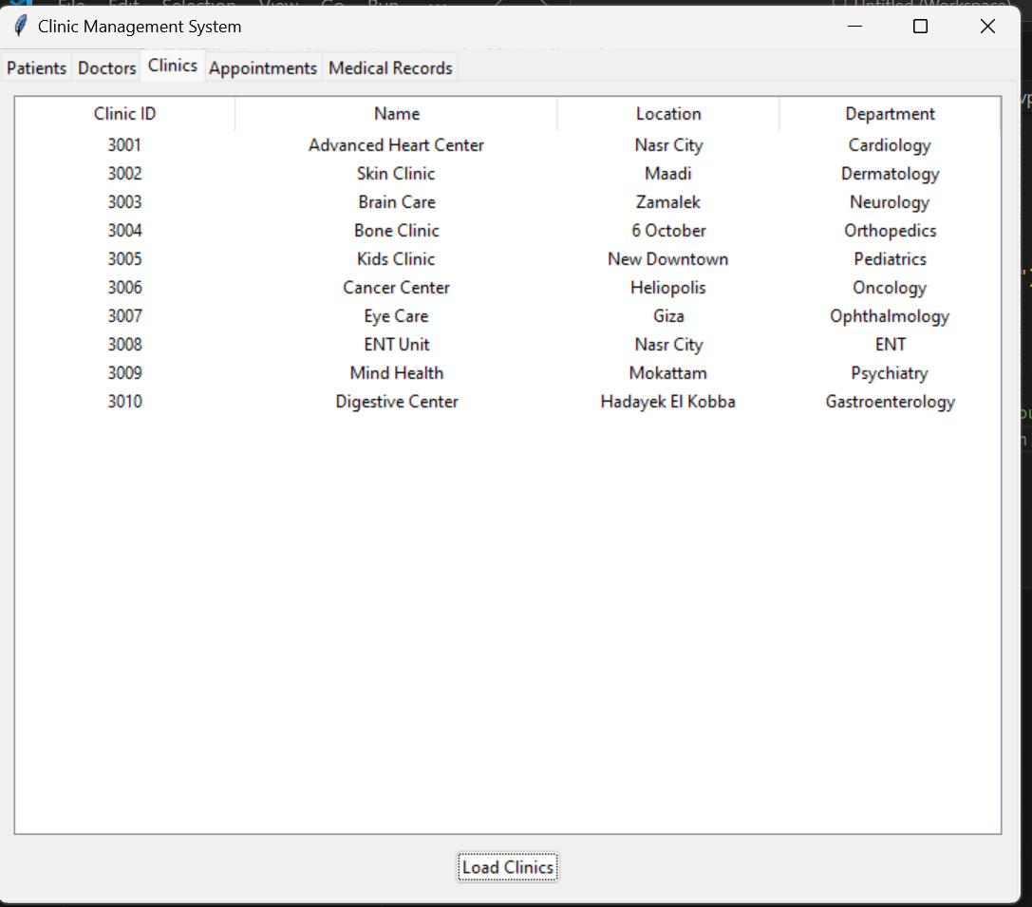
Clinics Records

Slide 18
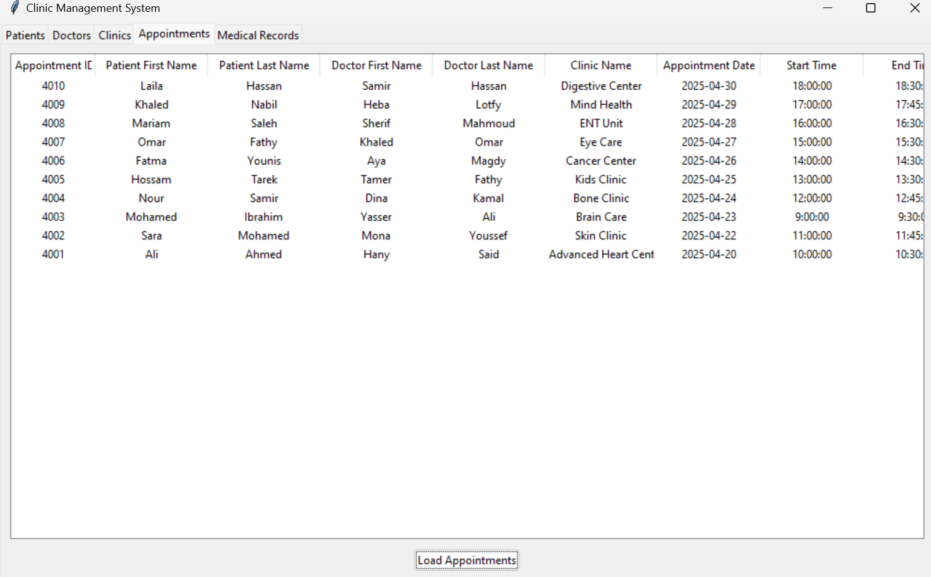
Appointments records

Slide 19
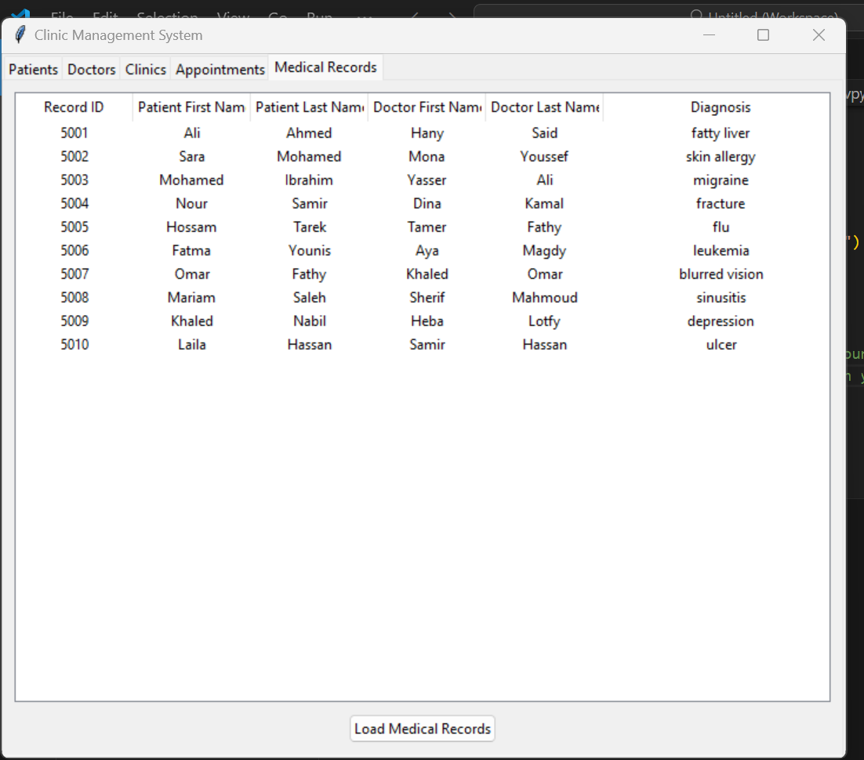
Medical records

Slide 20
Thank you!

